Slide 1
Depression Analysis using Audio Analysis
Group Members:
Honey Jain
Chinar Sakrikar
Kaushik Deshpande
Mangurish Bhagat

Slide 2
Problem Statement
An interview of 192 anonymous people has recorded in .wav file format. Some of the participants are clinically depressed, have been identified by the research team. The research team have classified them in the classes depressed and non- depressed. Our job is to correctly classify the participants.

Slide 3
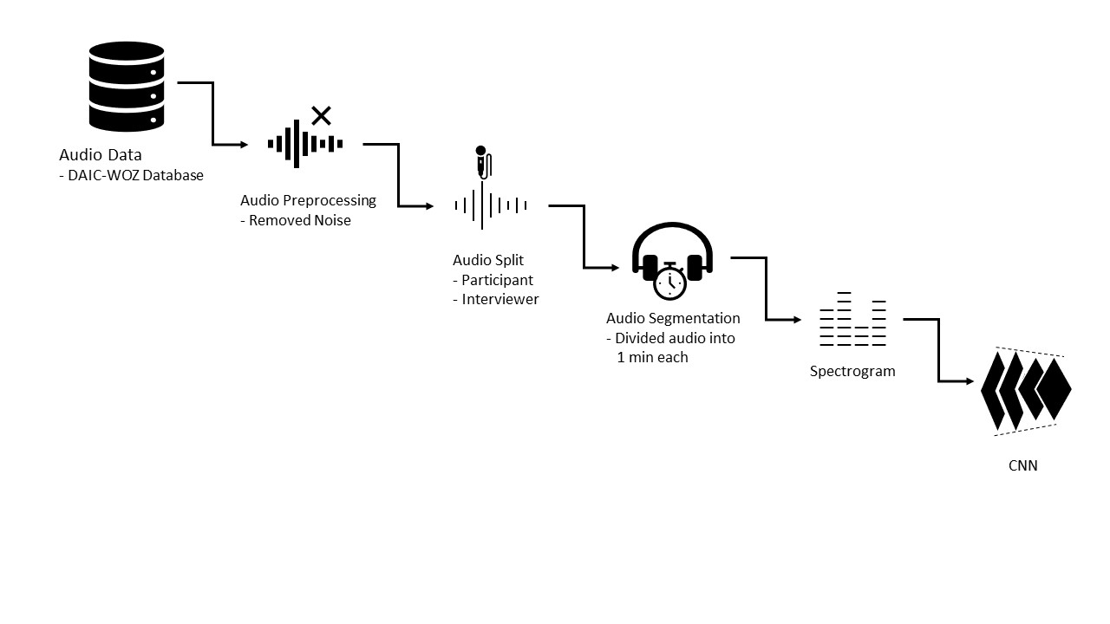
Sequence Diagram

Slide 4
Data
Data contain of clinical interviews designed to support the diagnosis of psychological distress conditions such as anxiety, depression, and post traumatic stress disorder
Data is of both Depressed and Non-Depressed
Depression and PTSD are both predicted by more tense voice features

Slide 5
Data Processing
Audio cleaning
Removing noise
Audio Splitting
Splitting voices of Interviewer and Participant
Audio Division
Sampling of split files in 1 minute division

Slide 6
Image Generation and Analysis
Converting Audio files into Images
Implementation of Spectrogram

Slide 7
Training of Model
Use of CNN Architecture
CNN Layers
2 Convolution Layers with ‘relu’ activation
2 Max Pooling Layer
5 Dense Layers with ‘relu’ activation
1 Dense Layer with ‘sigmoid’ activation
4 Dropout Layer
Metrics
Accuracy
Precision
Recall

Slide 8
Limitations
Not a scale medically
Only a small module of PHQ8 test for DIAZ
Depression is further scaled on 1 – 23 rank system, our work is limited to classification of depressed to non depressed
Limited Data is scaled

